Slide 1
Welcome to Marketing Management
Dr. Cecilia Ruvalcaba
BUSI 107 Week 1, Day 2

Slide 2
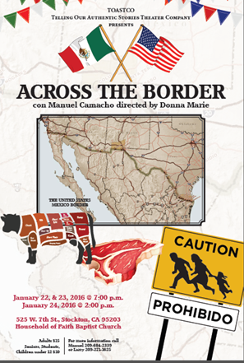
Margaret Roberts Email on Internship Programs!!!
Resume Workshop Jan 21, 26 & 28 at 12.
Mock Interview Week Feb 1-5!!!
January 29, 1-2pm. Place TBA. Professor Efraín Kristal, UCLA will talk about "Jorge Luis Borges on War".
(Kristal is one of the most important scholars on Borges, perhaps the most important Latin American Writer of the 20th Century).
Across the Border Performance

Slide 3
Chapter 1: Overview of Marketing

Slide 4
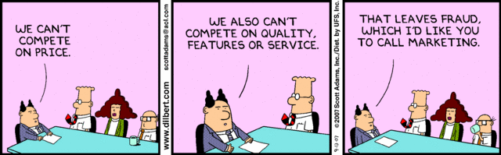
This is not marketing

Slide 5
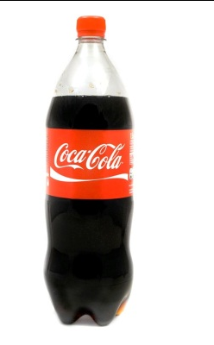

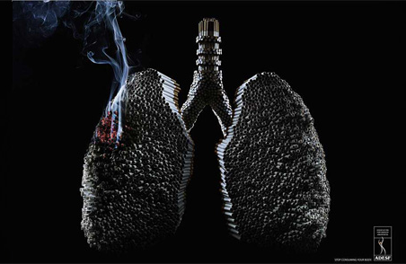


American Marketing Association
“the activity, set of institutions, and processes for creating, communicating, delivering, and exchanging offerings that have value for customers, clients, partners, and society at large.
Notes:
What if an empty coke bottles were never thrown away ?
http://www.adweek.com/adfreak/coca-cola-invents-16-crazy-caps-turn-empty-bottles-useful-objects-158136
https://www.youtube.com/watch?v=A_PuZxMBGLQ

Slide 6


Take Away for Today
Marketing is the foundation of everything!
Marketing Management… It’s all about the Customer!
What value are you providing?
Network, Network, Network

Slide 7

Next Class
Chapter 2: Marketing Strategies and the Marketing Plan
Chapter 10: Marketing Research
Syllabus Agreement
Submit Groups

